Slide 1
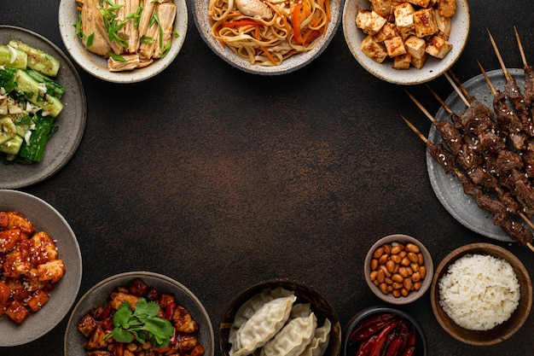
FOOD RECOMMENDATION SYSTEM FOR CUSTOMER
FOOD RECOMMENDATION SYSTEM
FOR CUSTOMER
BY
C. KISHORE KUMAR
NOV’22
BY
C. KISHORE KUMAR

Slide 2




Contents
CONTENTS PAGES
Project Overview & Scope 4
Project Goals 5
CRISP-ML(Q) Methodology 6
Technical Stacks 7
Project Architecture 8
Data Collection and Understanding 9
Data Information 10
Data Dictionary 11 - 13
System Requirements 14
Exploratory Data Analysis [EDA] 15 - 17
Data Visualization 18 - 27
Model Building 28 - 31
Model Deployment – Strategy 32
Screenshot of output 33 - 45
Video of output 46
Challenges 47
Future Scopes 48
Notes:
Change

Slide 3

Project Overview and Scope
PROJECT OVERVIEW
Recommendation system build for the multi – cuisine restaurant.
Model build for existing and New Customer based on previous order and New customer based on food.
Collecting the data from Primary source(survey).
Based on the collected data completing the preprocessing(EDA).
Storing the data in Azure tools. And performing the Recommendation System based on Content based Filtering to find out the recommendation of the food based on the customer historic information based on the ingredients preferred.
The prediction would be suggesting the recommended food to the customer.
This will be automatically performed based on the Machine learning model.
PROJECT SCOPE
The Vendor can efficiently predict customer recommended food orders which is faster, more efficiently and cost effectively based on historical data.
Predictive analysis helps decision makers in designing new recommendation strategies based on food orders which will help in customer improvement as well as overall growth to the business.

Slide 4

Project Goals
Business Objective:
The business objective to build a recommendation model to predict the recommended food based on customer exiting details or food mostly preferred by other customers for a multi cuisine restaurant.
Minimize: Customer non - preferred food
Maximize: Preferred food options to customer to increase the profits in business
Business Constraints:
Recommending the customer's food based on previous order.

Slide 5
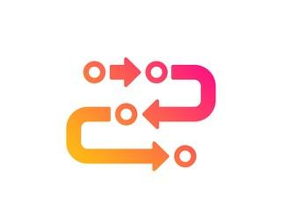
CRISP-ML(Q) Methodology
1a. Business Understanding: Understanding the Business Objects & Constraints for the Success Criteria
1b. Data Understanding: Understanding the Data Types which is collected.
2. Data Preparation: Data being Cleansed and explored for feature engineering
3. Model Building: Unsupervised Learning based model has been built - Recommendation System.
4. Evaluation: Model also build in Azure AML process for accuracy check.
5. Model Deployment: Model used in the application streamlit, docker and deployed the model in Microsoft Azure.
6. Monitoring & Maintenance: Should be done using the Azure Monitoring Application

Slide 6

Technical Stacks
The systems used to build the model.
Backend stacks
Programming language – Python
Application Used : Spyder, Microsoft Visual Studio, Docker image creator.
Library Used : Pandas, Pickle, Streamlit, NumPy, Simple Imputer, TfidfVectorizer, Linear Kernel
Data Preparation – Anaconda (Spyder & Jupyter notebook)
Data Storage- Microsoft Azure data storage.
Model Building - Microsoft Azure Machine Learning Workspace
Frontend stacks
App Development : Steamlit Webapp
Model Deployment : Microsoft Azure Web Services
Monitoring : Azure Monitoring & Maintenance
Notes:
Pycharm add Tableau

Slide 7
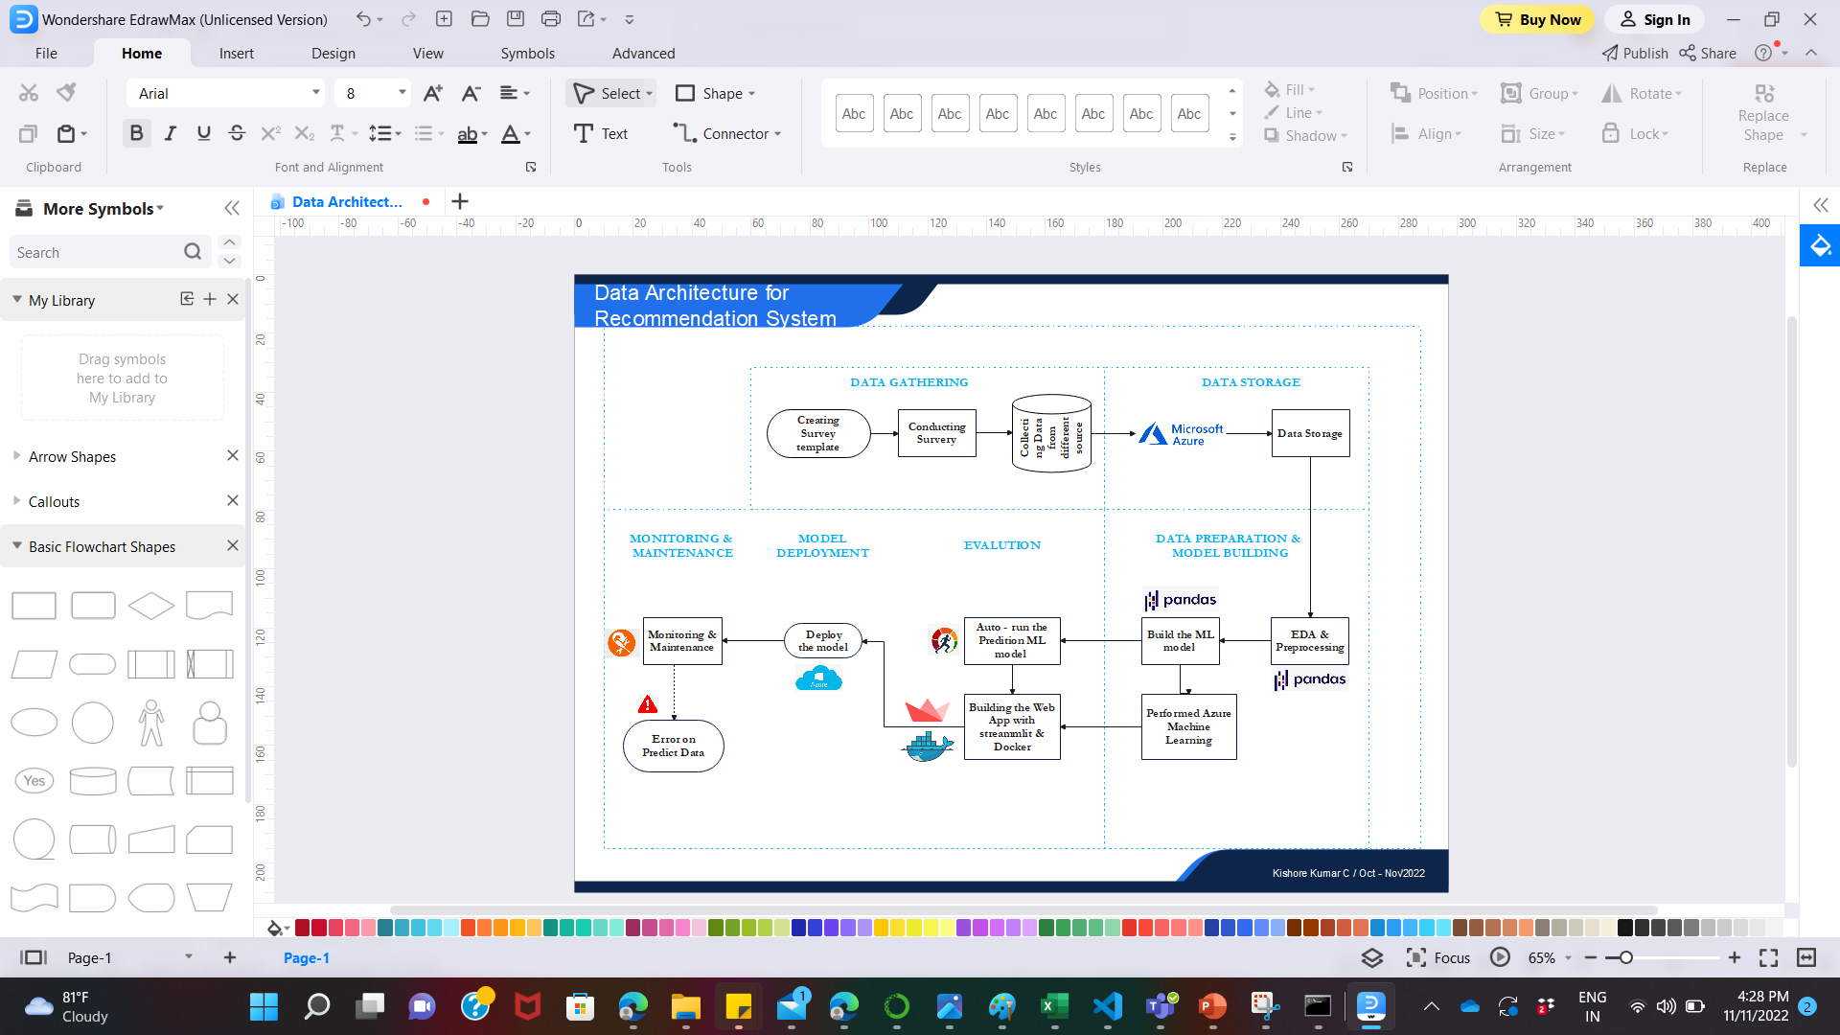
Project Architecture

Slide 8

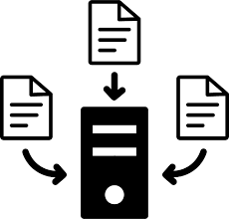

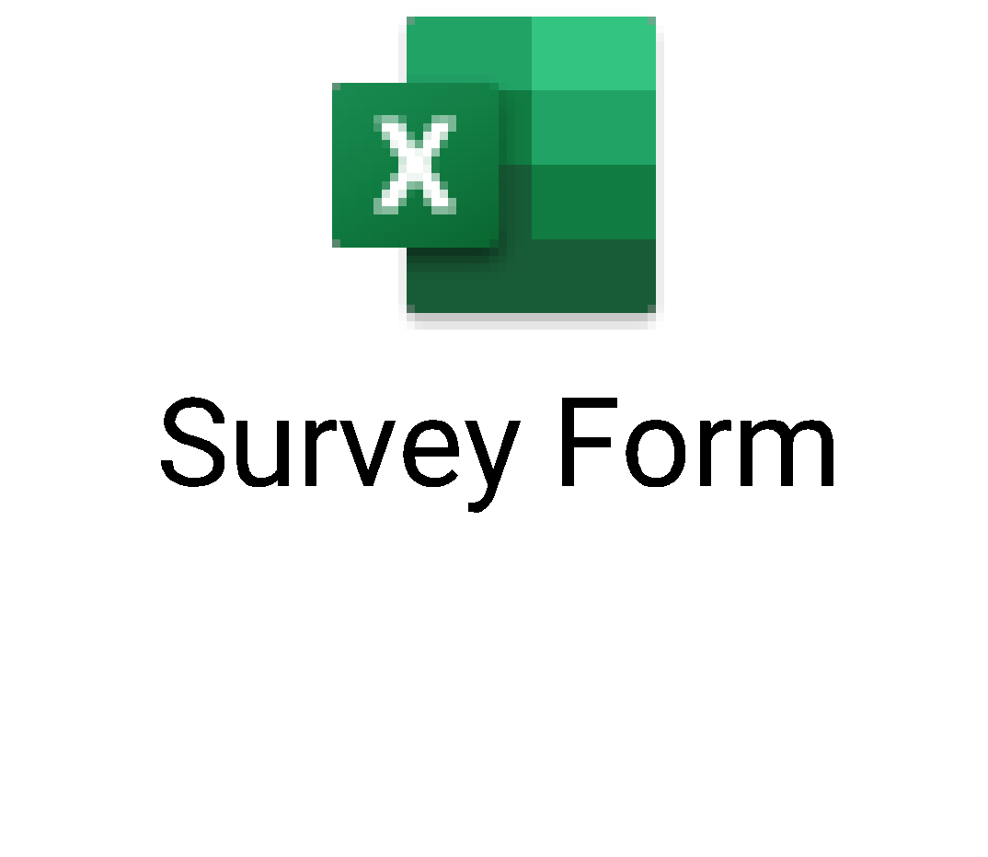
Data Collection and Understanding
Data Collection:
Primary Source :
Collecting the data from the customer based on survey responses.
Data Understanding:
Understanding the requirements of the objective and gathering those to provide the best output.

Slide 9

Data Information
Data gathering from the primary source is in the form of structured data.
Analyzing those data based on the objectives.
Survey Form and Data gathering has been done based on these Three Criteria :
Restaurant Customer Information | Restaurant Features about Customer | Customer Bill & Ratings
Name | Variety (Veg, Non-Veg or Both) | Total Bill
Age | Dining Type (Breakfast/Lunch/Dinner) | Rating
Gender | First Order (Dish Name) & Ingredients 1
Phone | Second Order (Dish Name) & Ingredients 2
Date & Day & Month | Third Order (Dish Name) - Ingredients 3
Email ID | Preferred Ingredients
 | Low Preferred Ingredients

Slide 10

Data Dictionary
Restaurant Customer Information
Name of the Features | Description | Type | Relevance
Name | Name of the customer who visit to the restaurant | Nominal | Irrelevant, Name does not provide useful information.
Age | Age of the customer | Ratio | Relevant, To identify the customer age for food selection
Gender | Gender of the customer | Categorical | Relevant, To identify which gender like which category of food selection
Phone | Phone No of the customer | Nominal | Irrelevant, Name does not provide useful information.
Date & Day & Month | Day & Month of the visited customer | Nominal | Relevant, To identify which day or date customer visits and what type food he likes.
Email ID | Email ID of the customer | Nominal | Relevant, To identify which gender like which category of food selection

Slide 11
Data Dictionary
Restaurant Features about Customer
Name of the Features | Description | Type | Relevance
Variety | Variety of the food selected by customers visit(i.e., Veg,Non-Veg or Both) | Ordinal | Relevant, To identify which variety of food selection the customer prefer.
Dining Type | Dining Type of the customer(Breakfast, Lunch or Dinner) | Ordinal | Relevant, To identify which dining type the customer prefer.
First Order (Dish Name) - Ingredients | First order of the customer with Ingredients | Nominal | Relevant, To identify which type of food the customer prefer.
Second Order (Dish Name) - Ingredients | Second order of the customer with Ingredients | Nominal | Relevant, To identify which type of food the customer prefer.
Third Order (Dish Name) - Ingredients | Third order of the customer with Ingredients | Nominal | Relevant, To identify which type of food the customer prefer.
Preferred Ingredients | Preferred Ingredients based on the food customer had. | Nominal | Relevant, To identify which ingredients the customers likes based on the food be had.
Low Preferred Ingredients | Low Preferred Ingredients based on the food customer had. | Nominal | Relevant, To identify which ingredients the customers likes based on the food be had.
Notes:
Table change

Slide 12
Data Dictionary
Customer Bill & Rating
Name of the Features | Description | Type | Relevance
Total Bill | Total Bill of the customer who visited to the restaurant | Ratio | Relevant, To identify how much amount would the customer like to spend.
Rating | Customer Rating based on food he had. | Ratio | Relevant, To identify the customer rating

Slide 13

System Requirements
Operating System: Windows 10
Anaconda Navigator System Requirements: Hardware requirements
CPU: 2 x 64-bit 2.8 GHz 8.00 GT/s CPUs.
RAM: 32 GB (or 16 GB of 1600 MHz DDR3 RAM)
Storage: 300 GB.
Anaconda Navigator Features Used: Software requirements
Spyder
Microsoft Visual Studio
Docker
Loading the Image in a Container : Docker Hub version 20.10.20
Public Repository : GitHub, Streamlit, Heruko
WebApp Creation – Streamlit version 1.14.0
Microsoft Azure – For Global requirements of the Webpage

Slide 14

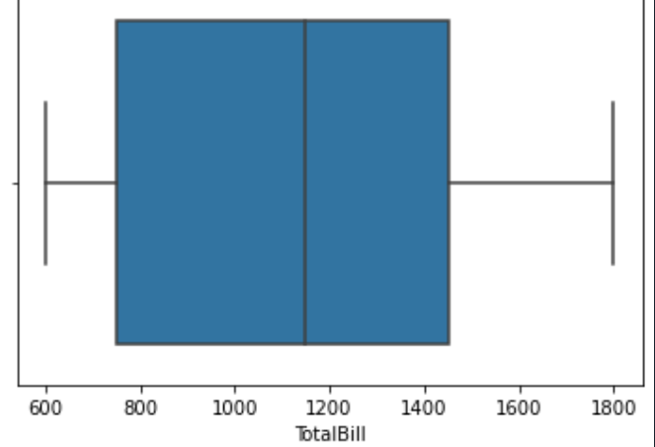
Exploratory Data Analysis [EDA]
Performed EDA on the Structured Datasets:
Dataframe: Most of the data variables falls under categorical types.. For Numeric variable without values performed the EDA.
Duplicates: Removed the duplicates value from the Dataframe.
Boxplot on Total Bills:
Dropping: Dropping the variables which does not have any value on the models. They are Name, Phone No, Date, Month, Main Ingredients1, Main Ingredients2, Main Ingredients3
Notes:
EDA is used for seeing what the data can tell us before the modeling task.
Change

Slide 15
EDA Description
Discretion: Performed for the data variables(i.e., Age, Total Bills & Rating):
Changing the numerical value to categorical value using Discretization
1. Age: Bins as [0, 16, 30, 38, 45, 60, 99] to be labeled as ['Child', 'Young Aged Adults', 'Middle Aged Adults', 'Old Aged Adults', 'Old Aged', 'Elderly’]
2.Total Bill: Bins as [0, 1000, 1500, 2000] to be labeled as ['Low Fair’, 'Medium Fair', 'High Fair’]
3. Rating: Bins as [0, 1, 2, 3, 4, 5] to be labeled as ['Worst', 'Poor', 'Average', 'Good', 'Excellent’]
Data Types: Changing the Data types from categorical to objects.

Slide 16
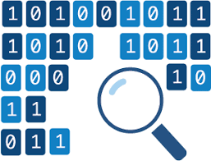
Missing Values Observation
Missing Variables (Rating): We can’t expect everyone to provide the rating. Hence the data has a missing values on the rating variables. For the missing value, used the Simple Imputation method based on Mean value to fill the blank value.

Slide 17
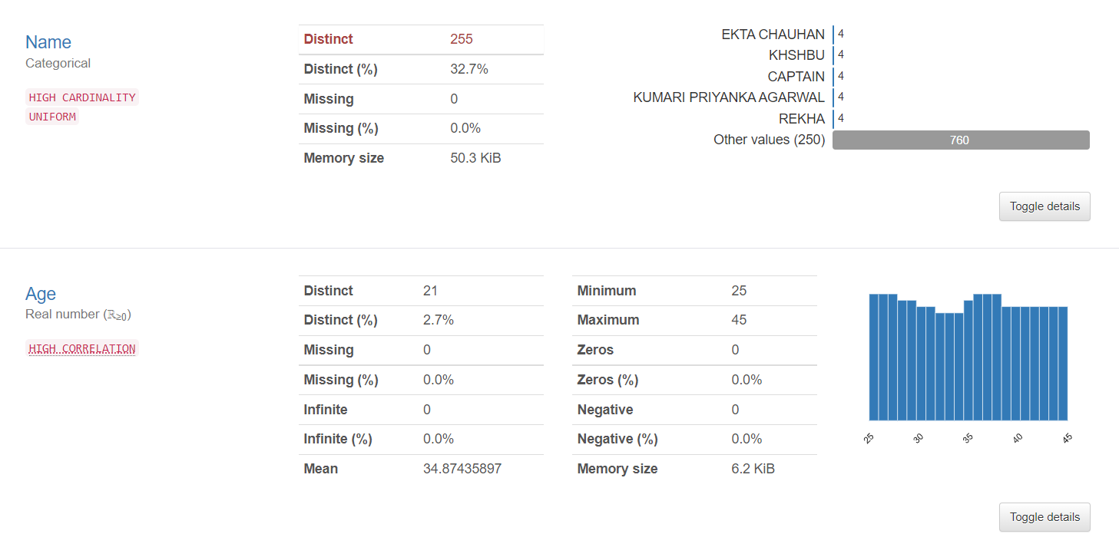
Data Visualization
Notes:
Keep observations

Slide 18
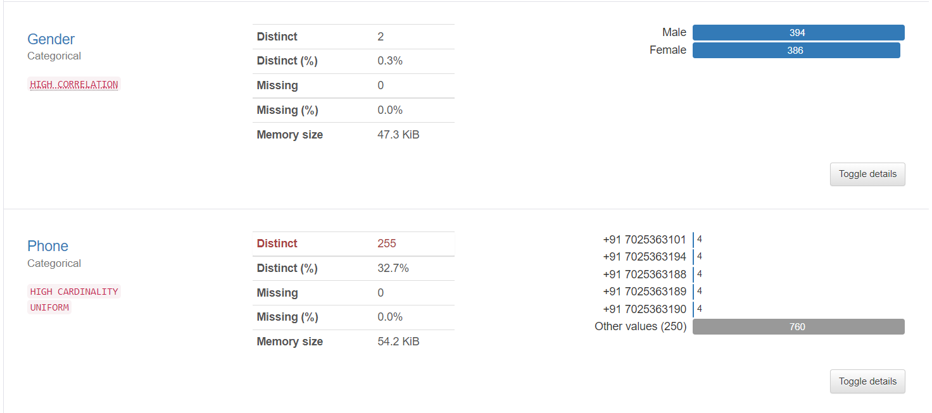
Data Visualization
Notes:
Add graphical

Slide 19
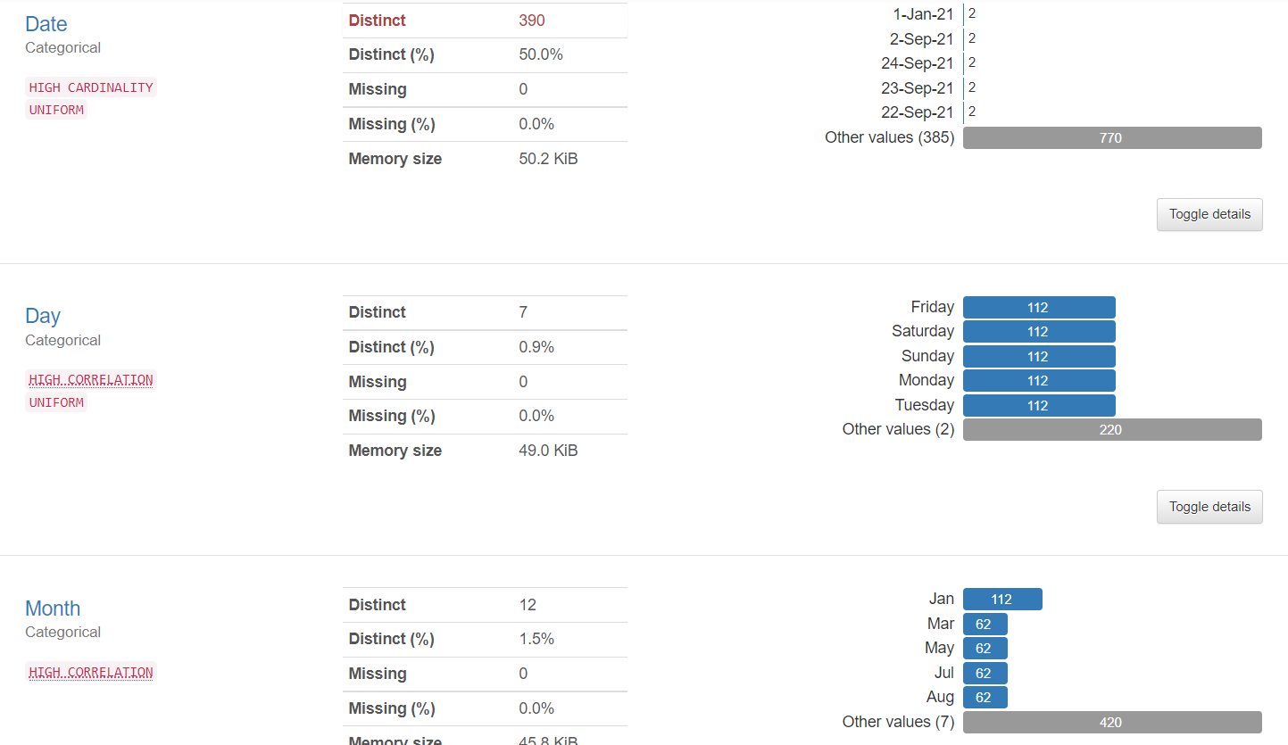
Data Visualization
Notes:
Piee

Slide 20
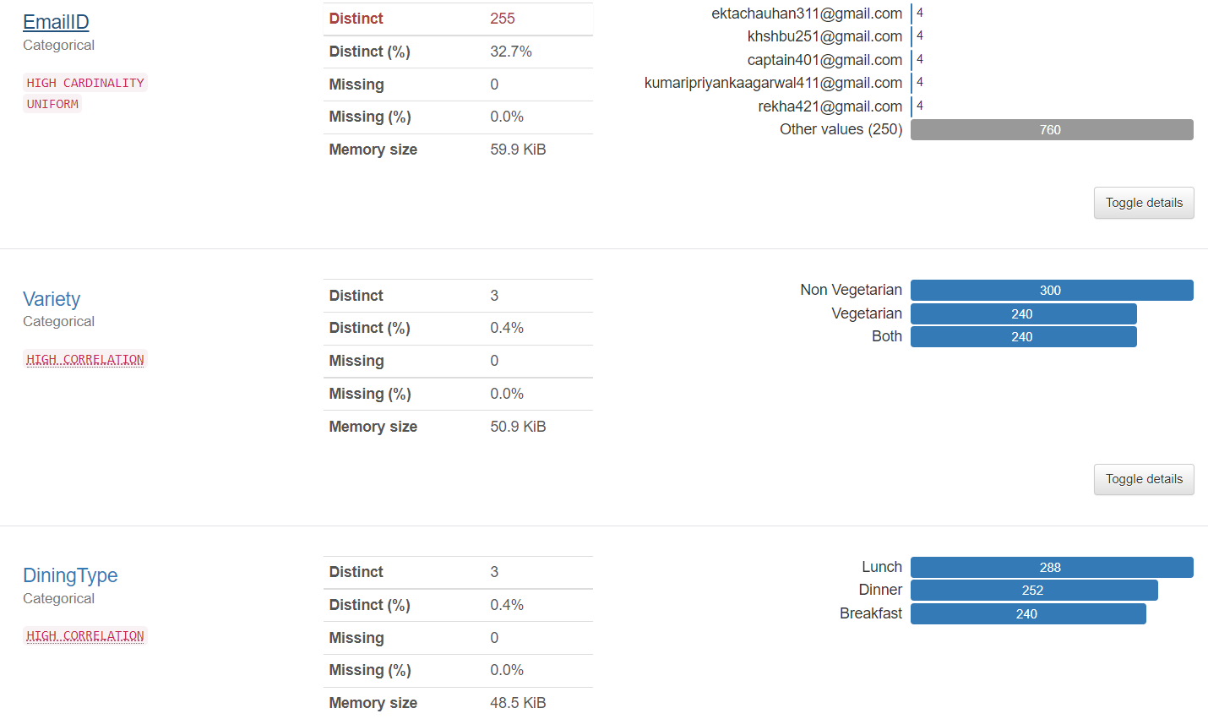
Data Visualization
Notes:
Piee

Slide 21
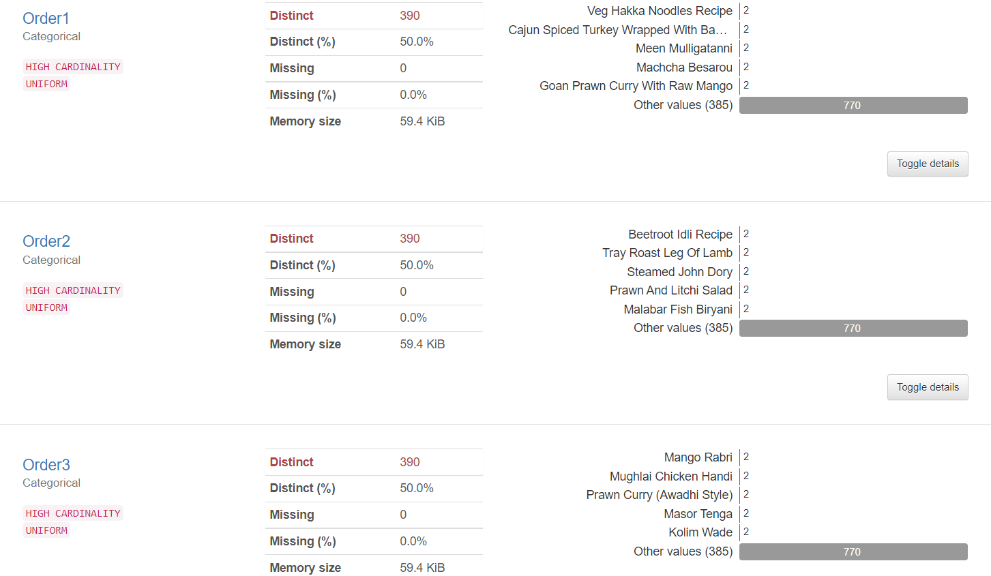
Data Visualization
Notes:
Piee

Slide 22
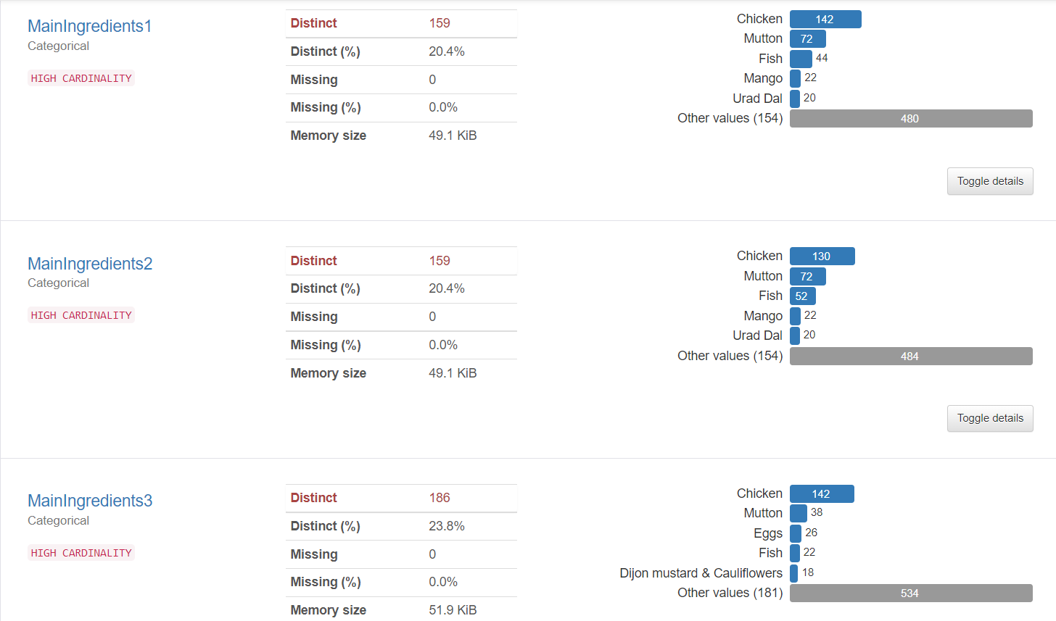
Data Visualization
Notes:
Piee

Slide 23
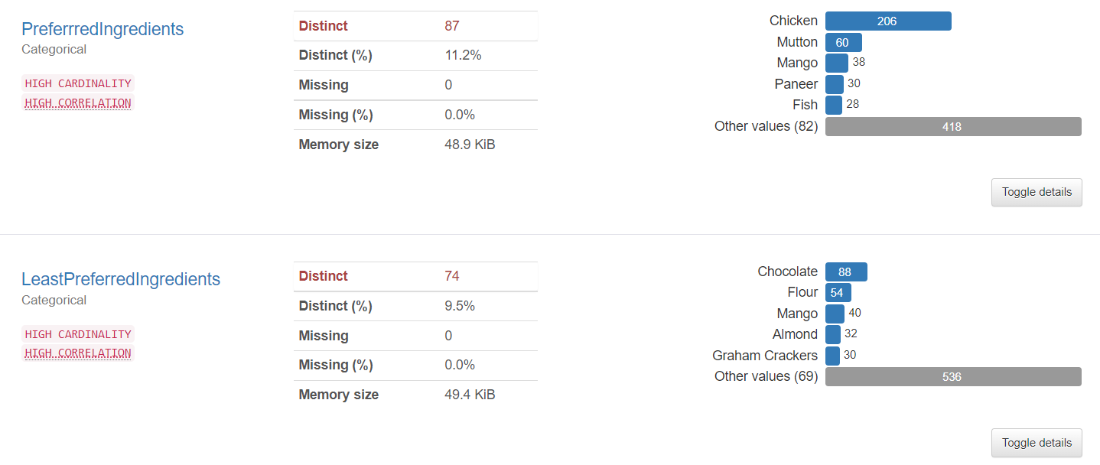
Data Visualization
Notes:
Piee

Slide 24
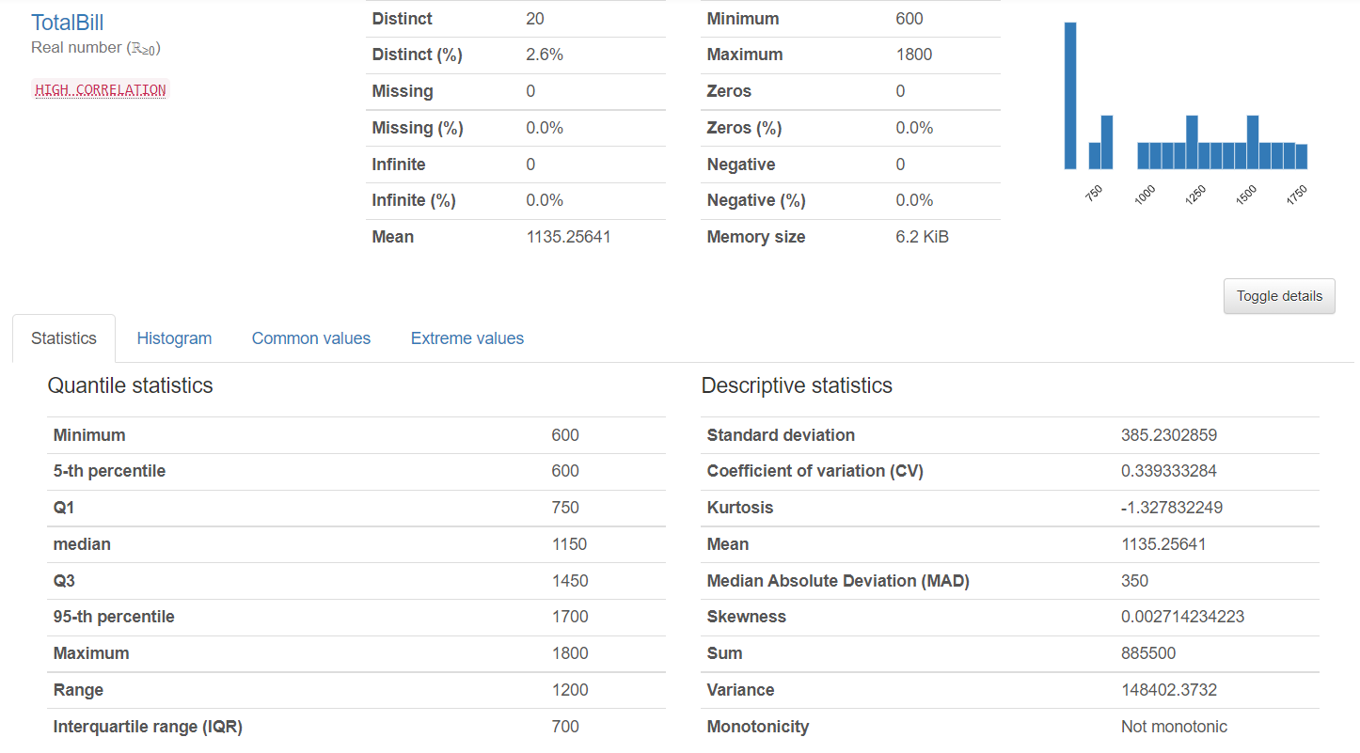
Data Visualization
Notes:
Piee

Slide 25
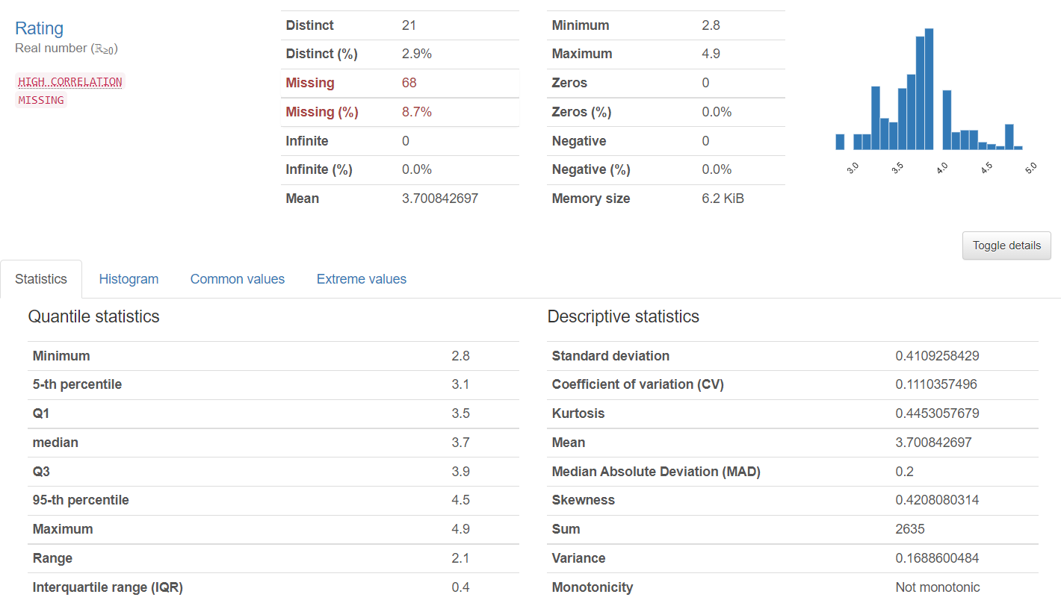
Data Visualization
Notes:
Piee

Slide 26
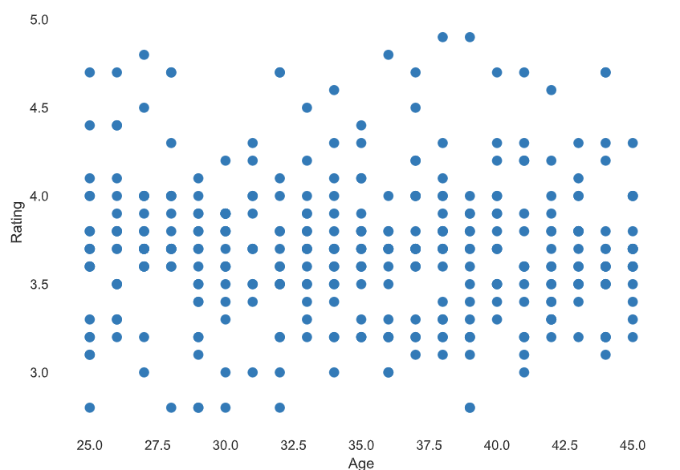
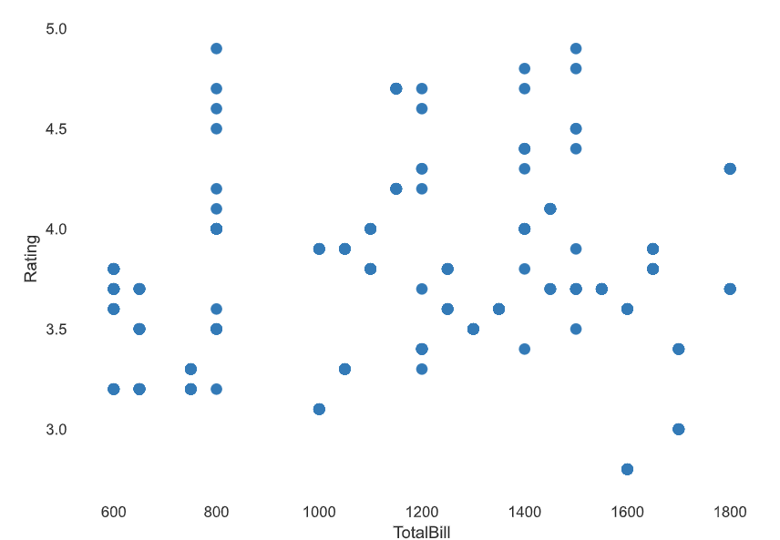
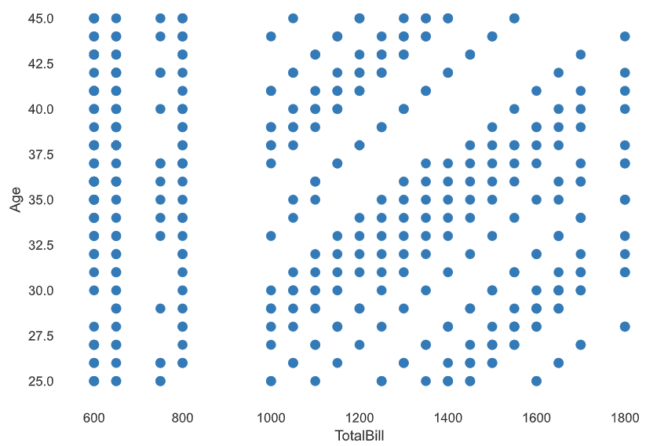
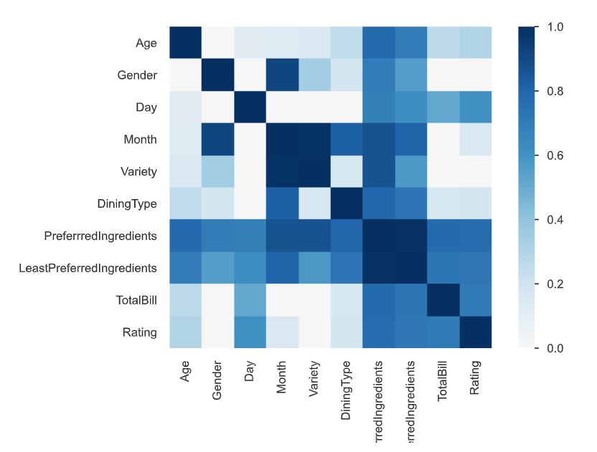
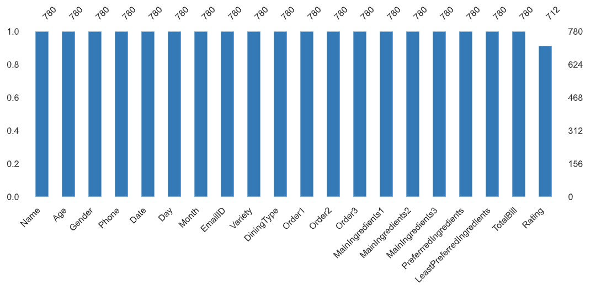
Data Visualization
INTERACTIONS
CORRELATIONS
MISSING VALUE
Notes:
Piee

Slide 27

Model Building
Model Building where tried to perform on all different criteria.
Azure Automatized Machine Learning methodology used to find the output of given datasets, whether the datasets are seems to be well enough to predict the model. Based on the runed model the system provided the best algorithm with good accuracy. The best algorithm in Automated ML model is MAxAbsScaler, LightGBM with the accuracy rate of 88%.
Azure Machine Learning Pipelines methodology used to build the pipelines of the datasets and model performed using Train-wide & Deep Recommender system. Which also provides the best results.
Python Recommendation System based on the above two model, python code written to provide the top 5 recommended food based on factorization on customer criteria information.(i.e., Unique Customer information – EmailID, Age, Gender factor, Day, Food Order, Main Ingredients, Preferred Ingredients, Low Preferred Ingredients, Total Bill & Rating)
Notes:
What is the role of regression in ML
Is regression supervised or unsupervised?

Slide 28
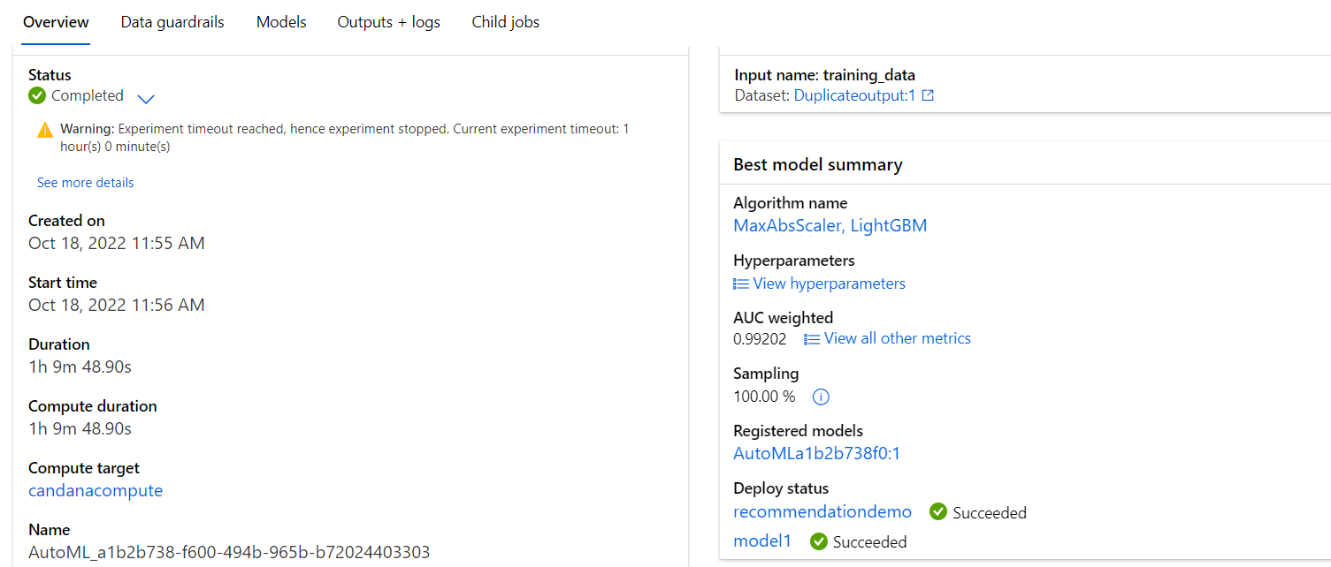
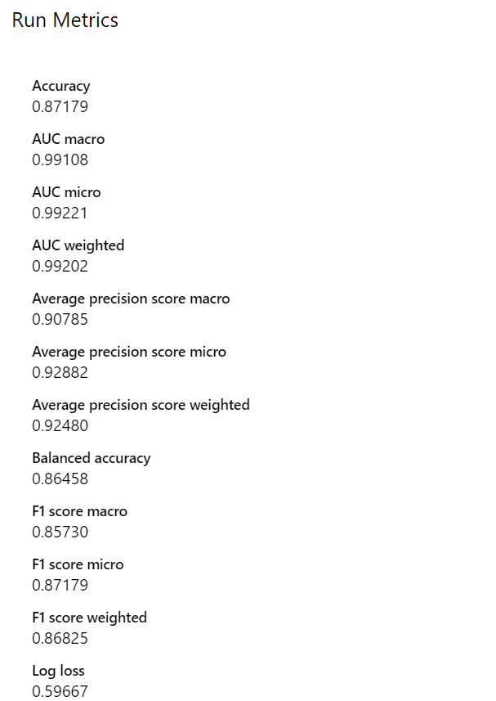
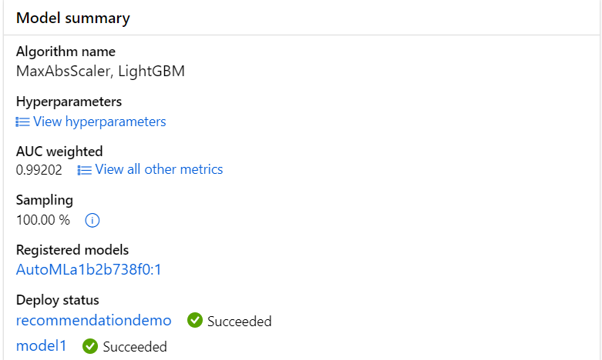
Model Building – Azure Auto Machine Learning
Performed the Azure Auto Machine Learning Model & Pipeline
Notes:
classification is the task of predicting a discrete class label. Regression is the task of predicting a continuous quantity.
What is classification techniques in machine learning?
The Classification algorithm is a Supervised Learning technique that is used to identify the category of new observations on the basis of training data. In Classification, a program learns from the given dataset or observations and then classifies new observation into several classes or groups.
What is regression techniques in machine learning?
Regression is a technique for investigating the relationship between independent variables or features and a dependent variable or outcome. It's used as a method for predictive modeling in machine learning, in which an algorithm is used to predict continuous outcomes.

Slide 29
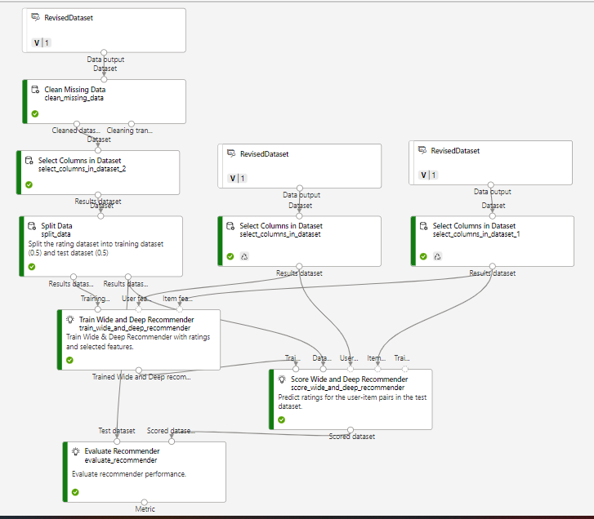
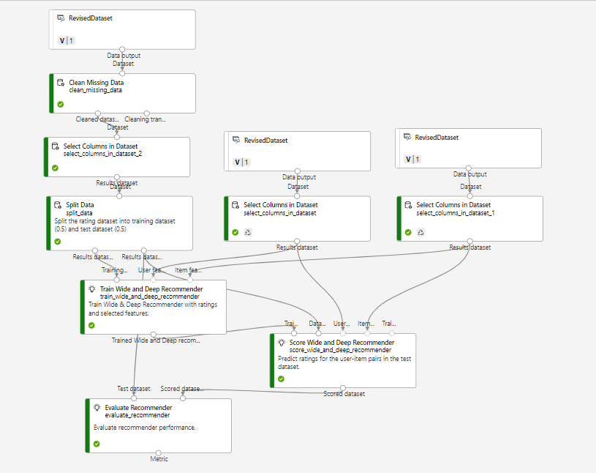
Model Building – Azure Designer
Notes:
classification is the task of predicting a discrete class label. Regression is the task of predicting a continuous quantity.
What is classification techniques in machine learning?
The Classification algorithm is a Supervised Learning technique that is used to identify the category of new observations on the basis of training data. In Classification, a program learns from the given dataset or observations and then classifies new observation into several classes or groups.
What is regression techniques in machine learning?
Regression is a technique for investigating the relationship between independent variables or features and a dependent variable or outcome. It's used as a method for predictive modeling in machine learning, in which an algorithm is used to predict continuous outcomes.

Slide 30
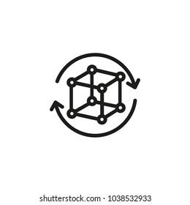
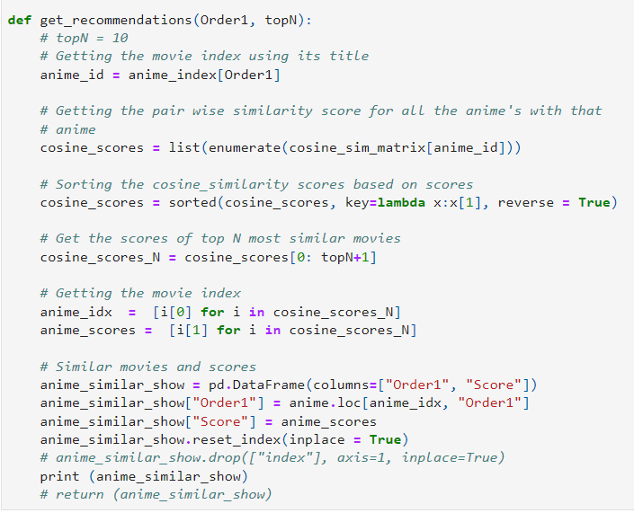
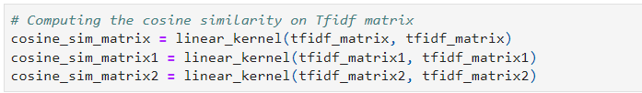
Best Model – RECOMMENDATION SYSTEM
Best Model build using the Term Frequency Inverse Document Frequency Vectorization & Cosine Similarity Formula and recommendation output.
1. The term frequency Vectorization algorithm used to factorize all customer requirements. To Build for Three Food order of the customer.
2. Finding out the cosine similarity on Tf Idf matrix for three orders.
3. Defining the Recommendation based on Tf Idf & cosine similarity on food order
Notes:
Why Random Forest Regression is good?
A Random Forest Regression model is powerful and accurate. It usually performs great on many problems, including features with non-linear relationships
How is XGBoost different from random forest?
One of the most important differences between XG Boost and Random forest is that the XGBoost always gives more importance to functional space when reducing the cost of a model while Random Forest tries to give more preferences to hyperparameters to optimize the model..
n_estimators — the number of decision trees you will be running in the model

Slide 31

Model Deployment - Strategy
https://kishoreproducts.azurewebsites.net
APPLICATION REQUIRED
Microsoft Visual Studio – Backend system to build the model via python code.
Streamlit – Its a Web app tools, which can be used in MVS after installation.
Docker - It’s an Image converter. Convert the model in an image and stored in a container will be used in deploying an azure cloud platform.
Microsoft Azure – It’s a global system to deploy model in azure system for vendor access.

Slide 32
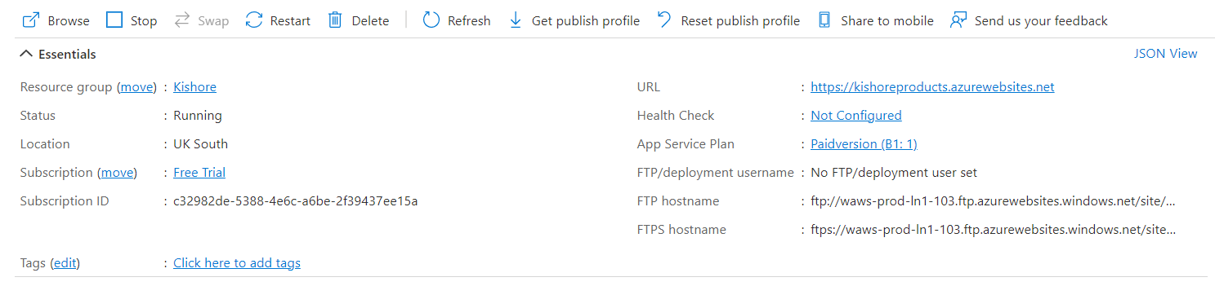
Screen shot of output – AZURE APPLICATION
Web App created on Azure cloud platform:

Slide 33
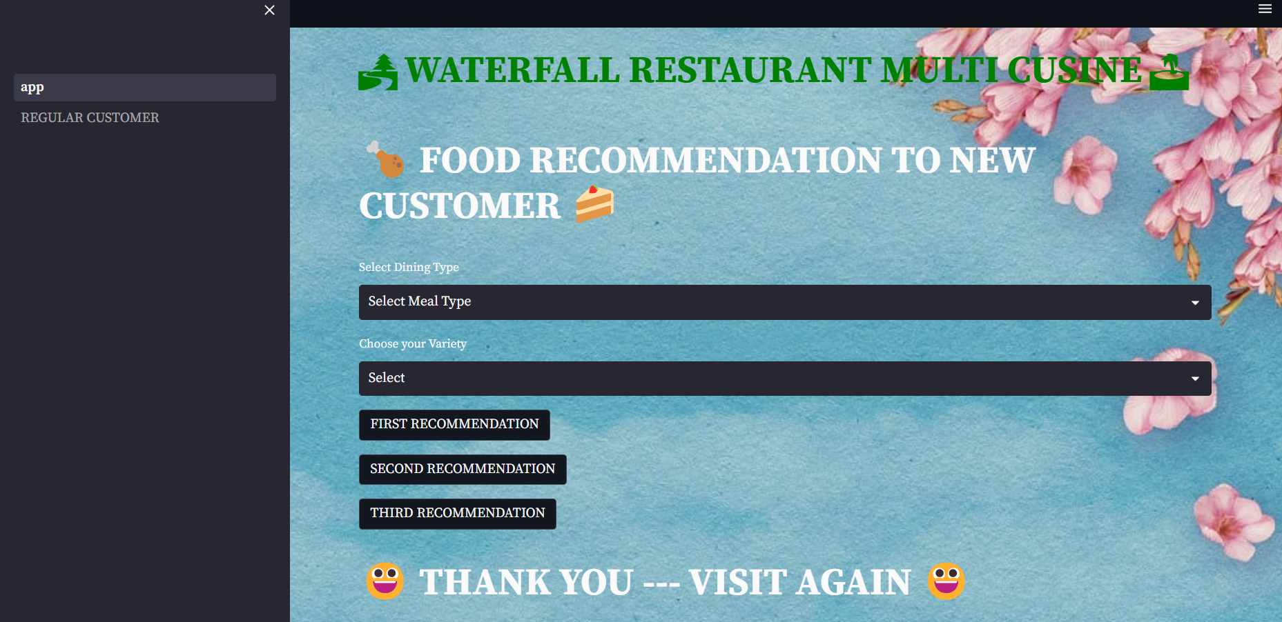
Screen shot of output - NEW CUSTOMER
Webapp - NEW CUSTOMER

Slide 34
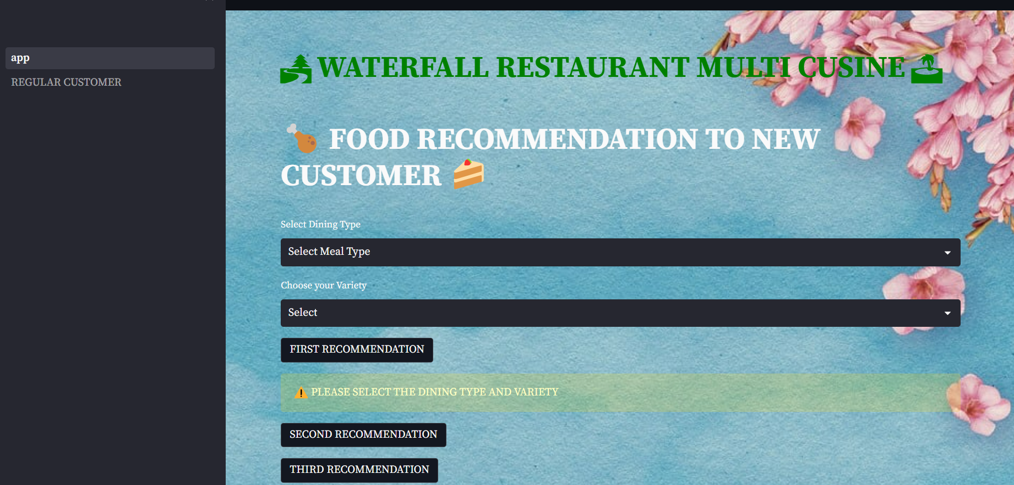
Screen shot of output – NEW CUSTOMER
Unselect of Dining type and variety - shows the warning msg to select the item:

Slide 35
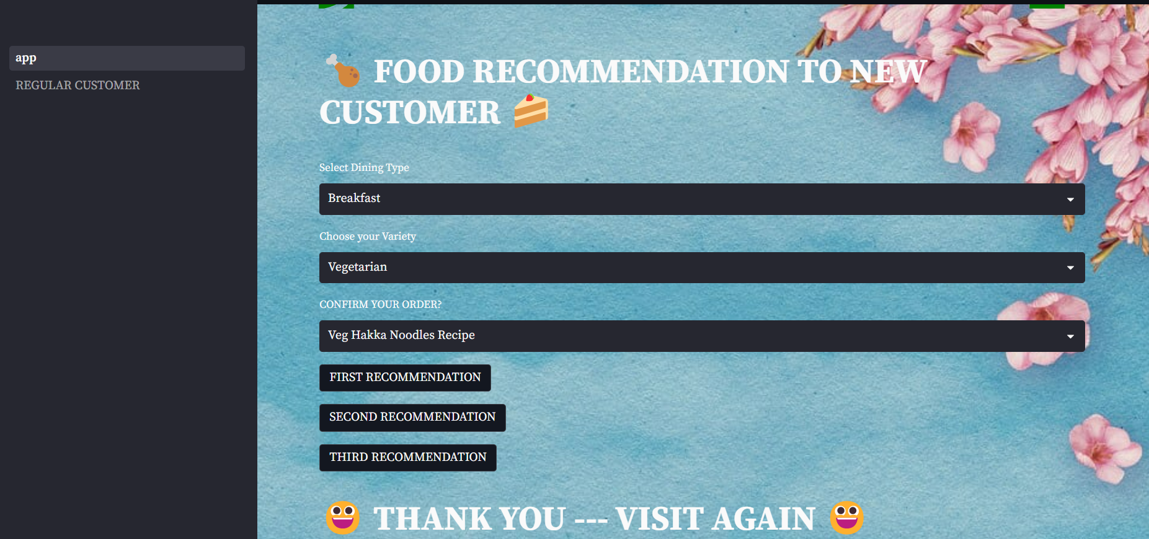
Screen shot of output - NEW CUSTOMER
Based on the selection of Dining & Variety, the food items will be changed and shown::

Slide 36
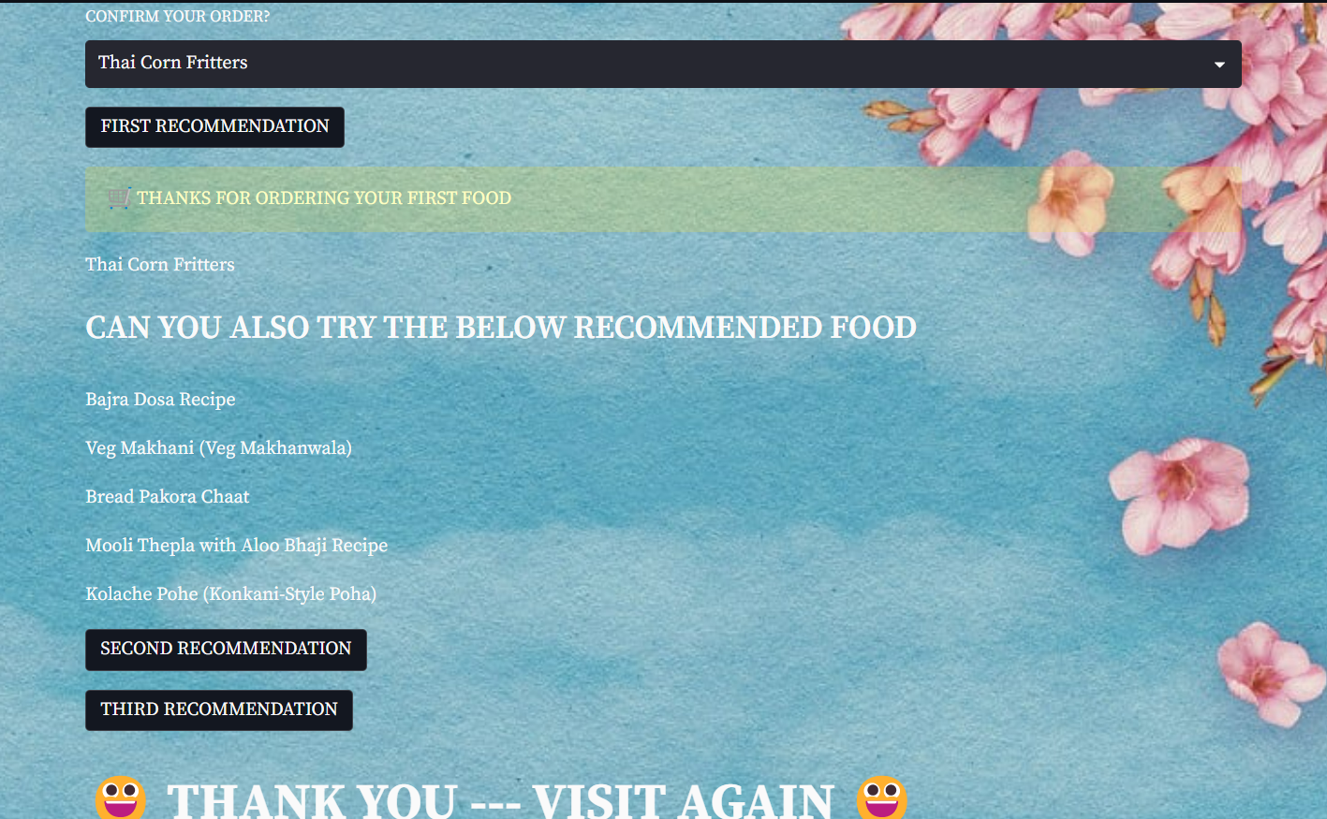
Screen shot of output - NEW CUSTOMER
Based on the food selection, once you clicked the first recommendation the top 5 recommending foods will be shown:

Slide 37

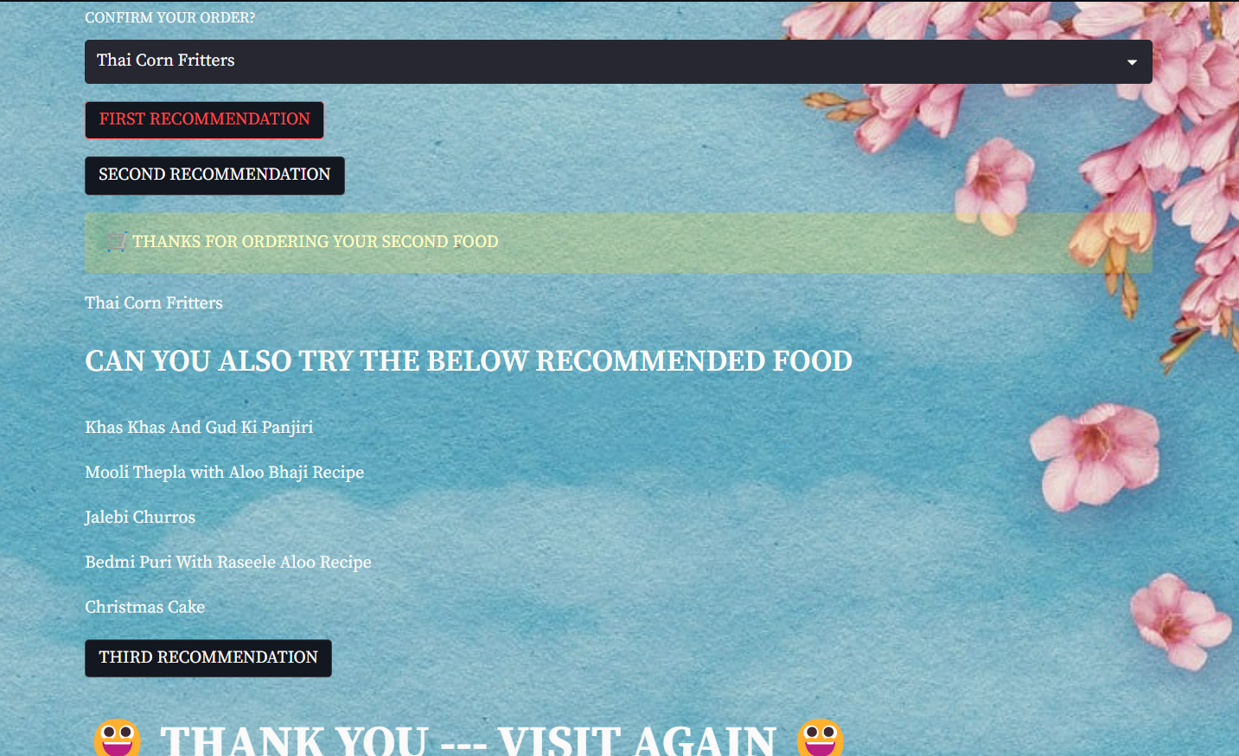
Screen shot of output - NEW CUSTOMER
Based on the food selection, once you clicked the second recommendation the top 5 recommending foods will be shown: but the first and second recommended foods will vary:

Slide 38
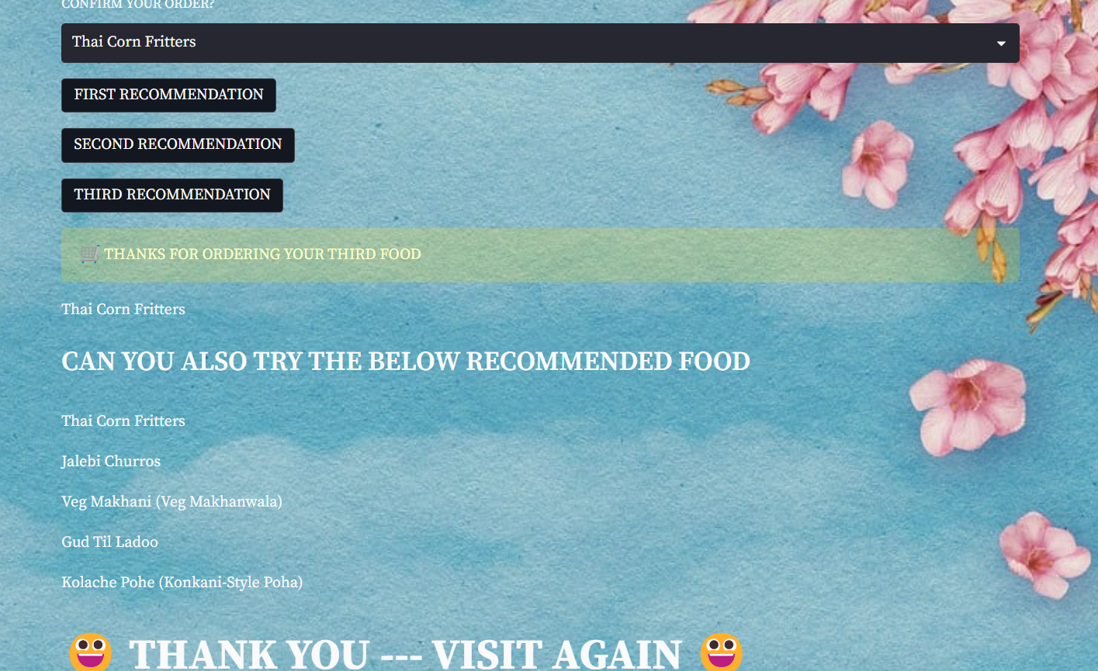
Screen shot of output - NEW CUSTOMER
Based on the food selection, once you clicked the third recommendation the top 5 recommending foods will be shown:

Slide 39
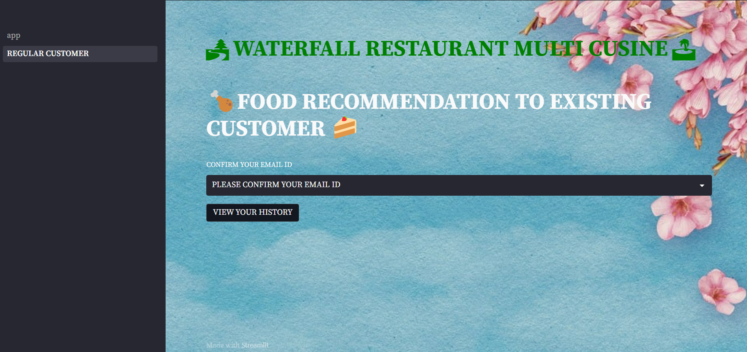
Screen shot of output – REGULAR CUSTOMER
WEB PAGE – For Regular Customer Recommending the food who visits the Restaurant

Slide 40
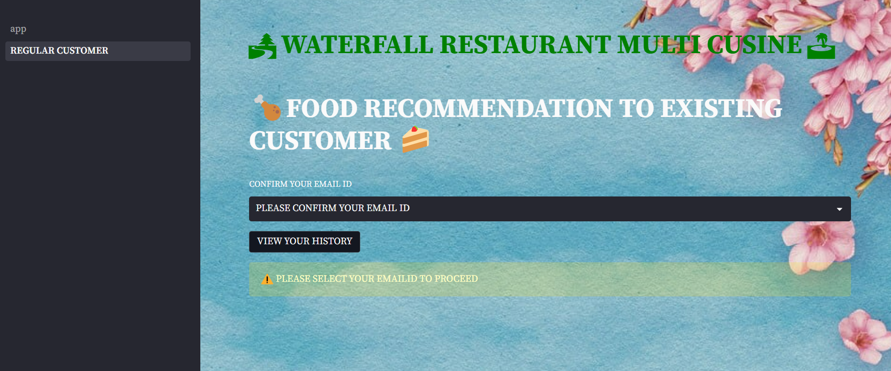
Screen shot of output – REGULAR CUSTOMER
Unselect of Email ID shows a warning alert, will be displayed to select the customer email ID

Slide 41
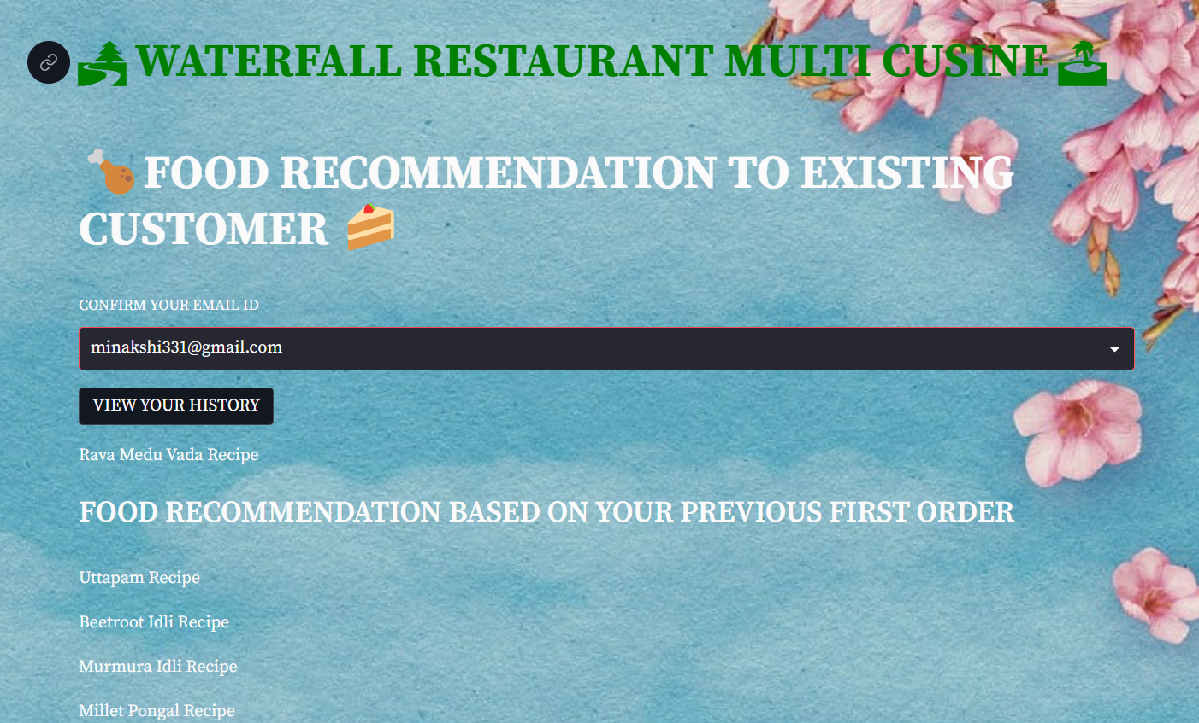
Screen shot of output – REGULAR CUSTOMER
Based on the selection of customer email id, the recommended food list of the top 5 food will be displayed as a first order – Previous Item name has been listed on the top automatically

Slide 42
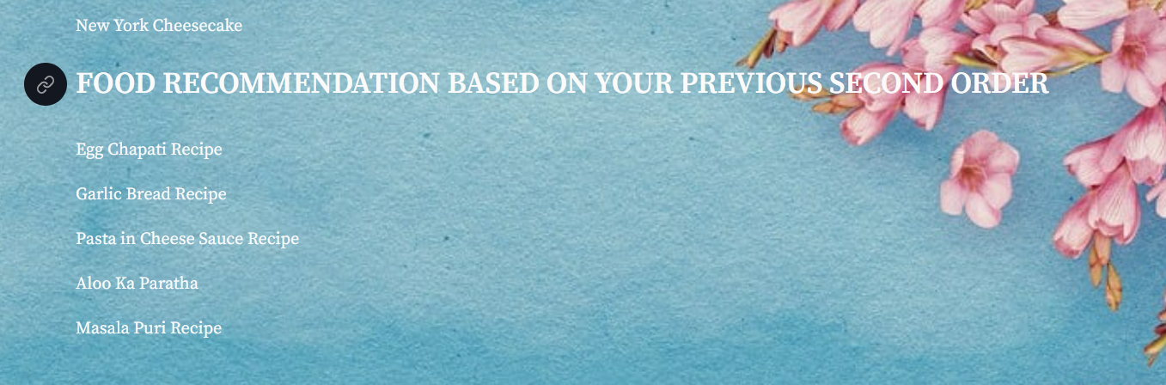
Screen shot of output – REGULAR CUSTOMER
Based on the earlier food recommended the top 5 food on second order – Previous Item name has been listed on the top automatically

Slide 43
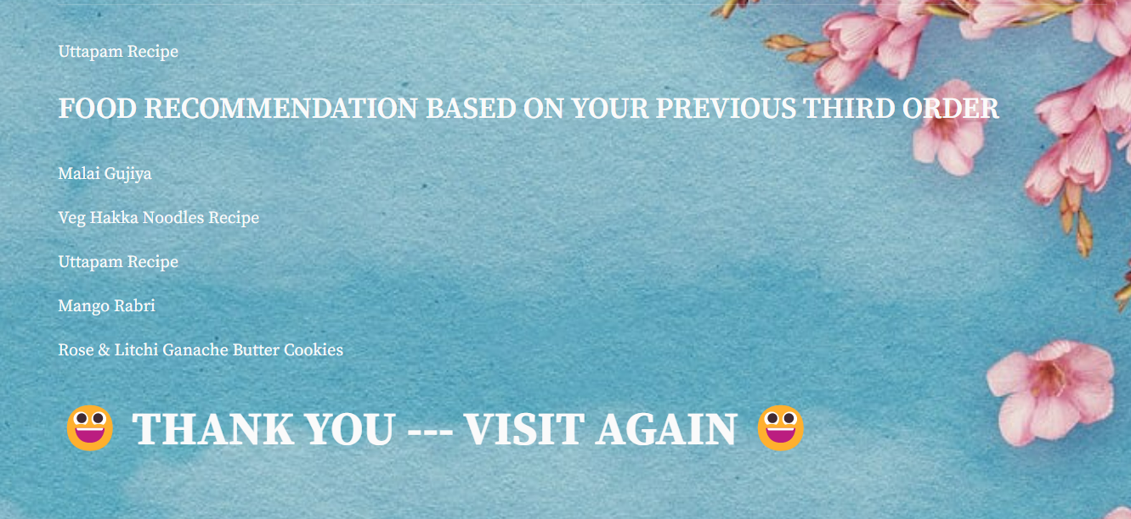
Screen shot of output – REGULAR CUSTOMER
Based on the earlier food, recommended the top 5 food on third order – Previous Item name has been listed on the top automatically

Slide 44
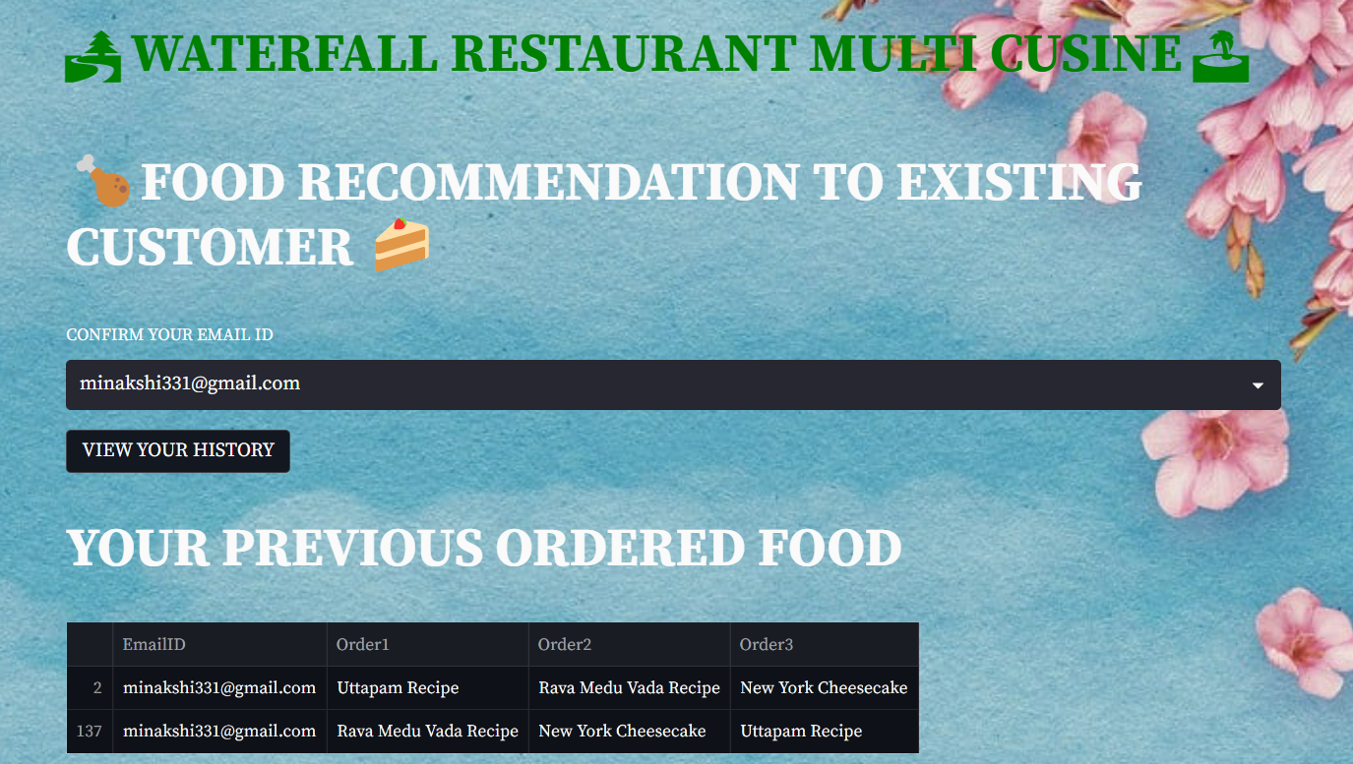
Screen shot of output – REGULAR CUSTOMER
To view the previous ordered food of the customer, click on the “VIEW YOUR HISTORY”

Slide 45
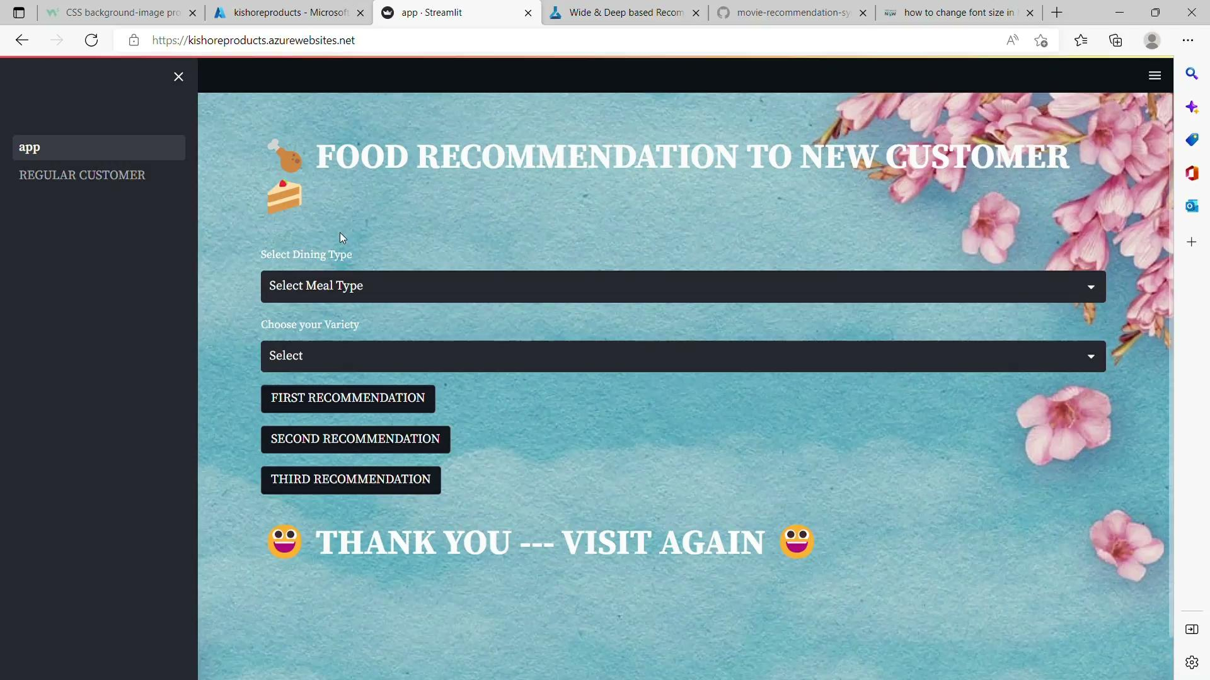
Video of output

Slide 46

Challenges
Data being collected via survey for this projects, whether this dataset will had value to the business.
Since the data being collected through primary source the data can be bias when we use this data for business requirement.
Monitoring & Maintaining the cloud platform based on this model will be difficult.
The predictive model will not be suitable for this project.

Slide 47
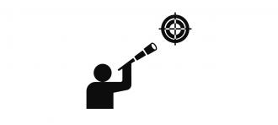
Future Scopes
The model built in global cloud platform requirements can be change or done easily.
Monitoring and Maintaining the prediction value based on the food & customer criteria to get the good accuracy.
New items of food and new customer details need to be incorporated in model in future.

Slide 48

Queries ?

Slide 49


